Slide 1

Synthetic Retail Data Generator

Slide 2
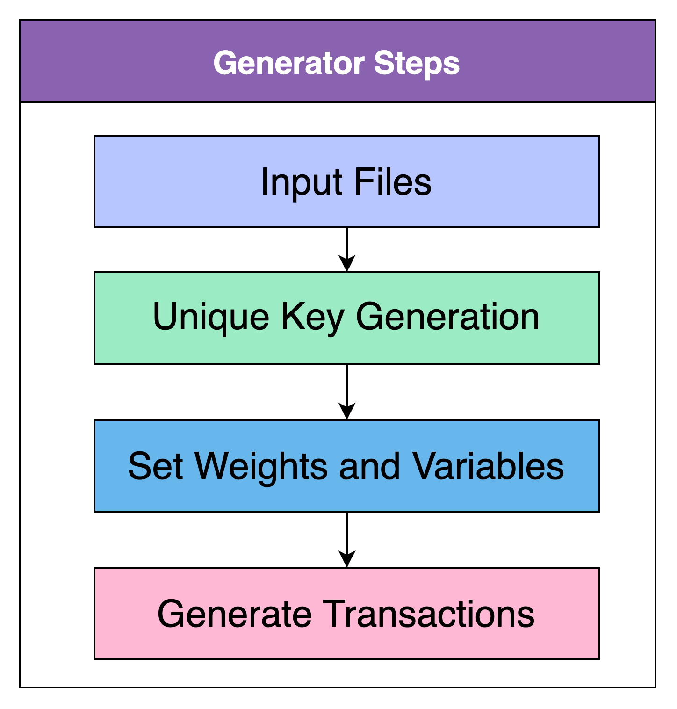
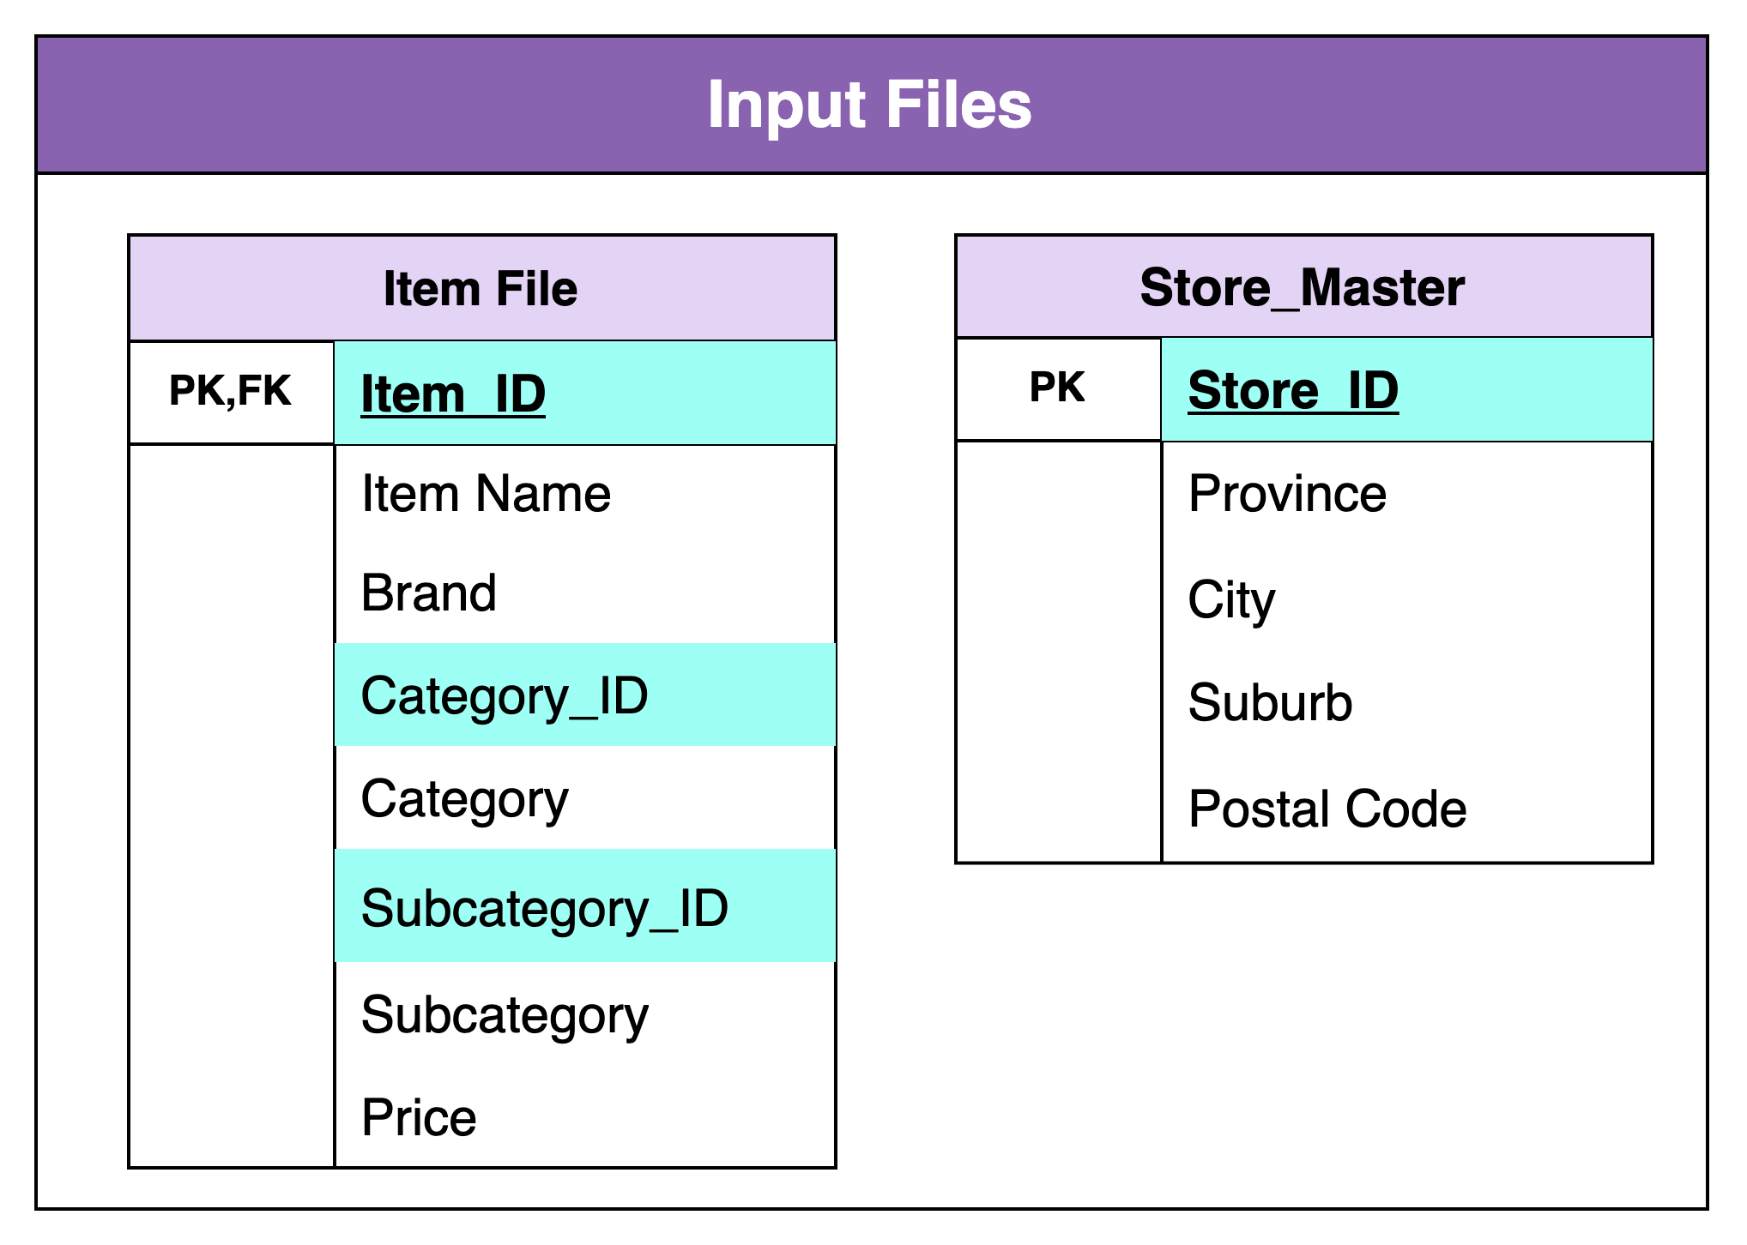
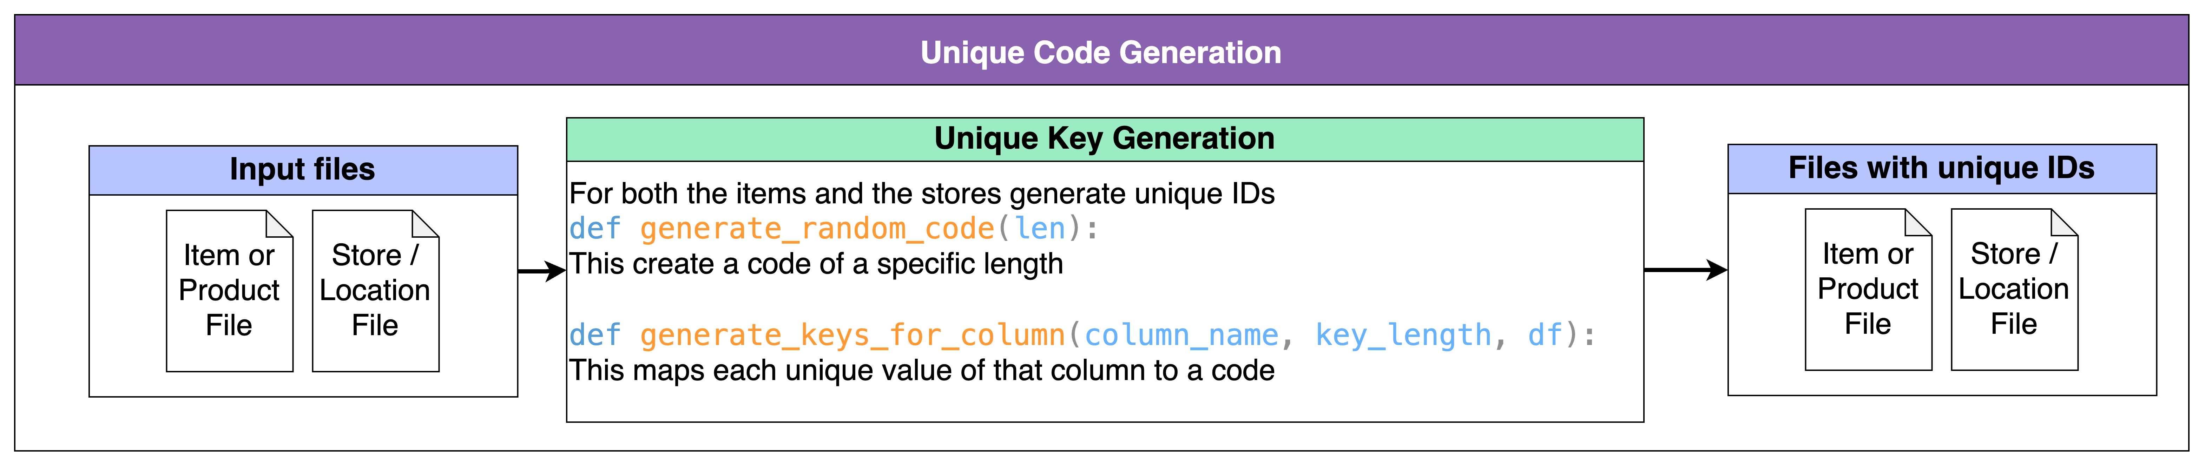
Overview of the flow
This is the basic flow of the Synthetic Data Generator.
The input files are:
Item or Product File
Store or Locations File
The columns highlighted in these input files are ones that can get generated by the ”Unique Key Generation” Step. If we already have the unique codes or if these unique codes are not needed this step can be skipped

Slide 3
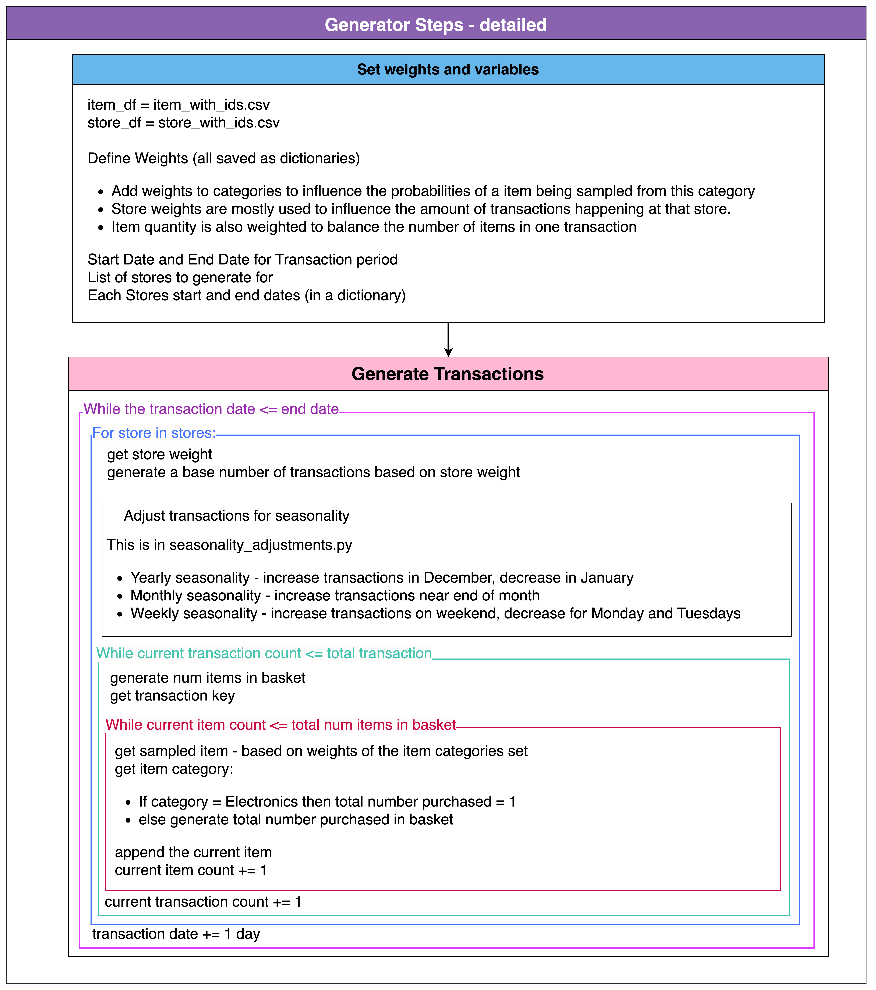
Detailed Flow
The generator has two main steps - generation of total transactions of a day in a store and the “basket” of the transaction.
Number of transactions is affected by:
User defined store weights
Seasonality adjusting
The current transaction or basket is affected by:
A randomly generated number for total number of UNIQUE items purchased
A item sampler that samples based on category
A random multiplier for the total of that single item purchased.
The basket step can be skipped if users are only buying one item per purchase for cases like insurance.

Slide 4
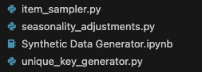
Python Script
These are the python scripts used to create the synthetic data.
“Synthetic Data Generator.ipynb” is where the data is created.
The other files just contain the functions used in the generator. They are separated out so we can make changes to the functions outside of the generator to test different methods.

Slide 5
Future Improvements
Events
Events or holidays to affect the total sales
Promotions and Sales
Promotions and sales on item prices
Promotions and sales affect on quantity sold
Customer Loyalty points and system
Promotions or sales based on Loyalty Card
Loyalty Points
Loyalty Point to pay
Customer Profiles

